Slide 1
SELENIUM WEBDRIVER USING JAVA
SWAG LABS SOFTWARE TESTING PROJECT

Slide 2
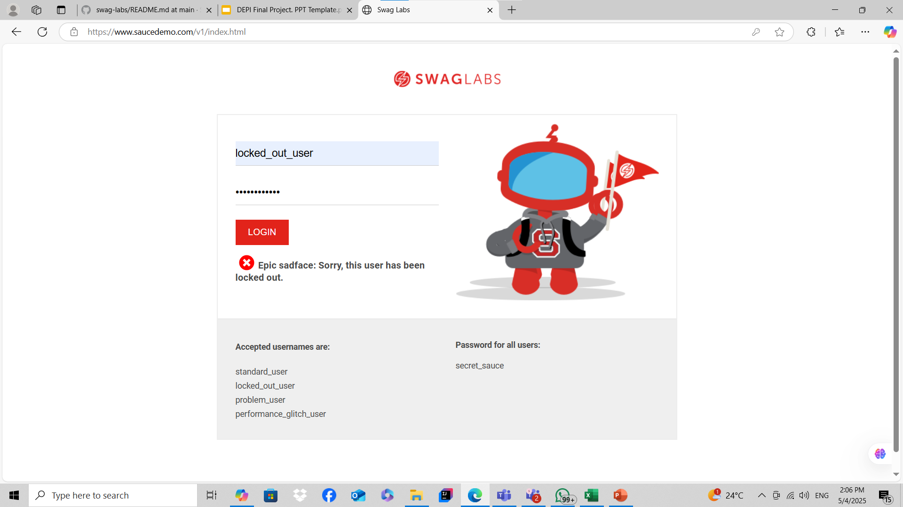
Project Idea:
Swag Labs faces challenges like bugs, security risks, and performance issues, impacting user trust. This project aims to enhance reliability through a mix of automated and manual testing, ensuring smooth functionality.
The unique approach lies in real-world test cases, combining automation with manual insights to uncover hidden flaws. Not only does it detect issues, but it also proposes targeted improvements, making Swag Labs more stable and user-friendly.
.

Slide 3
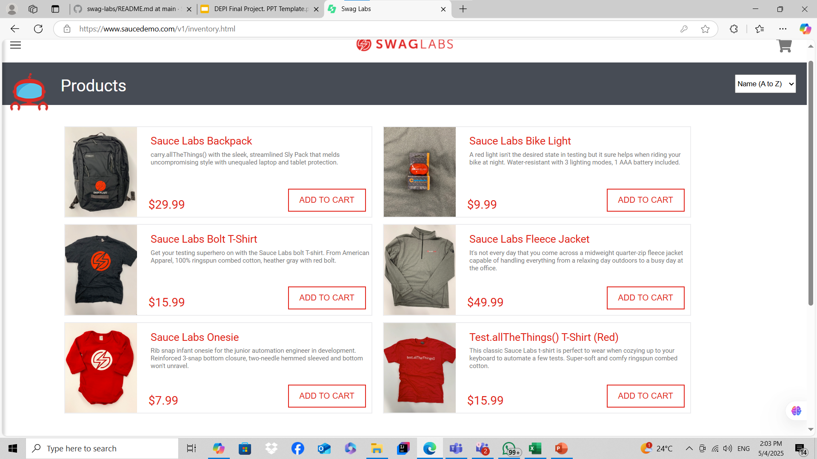
Project Wireframe :
User Journey Overview:
How users navigate through Swag Labs:
Onboarding: Login or sign-up process.
Exploring Products: Browsing through available items.
Adding Items to Cart: Selecting and reviewing purchases.
Checkout & Payment: Securing the order.
Order Confirmation: Tracking and managing past orders.
Focus on Usability & User Experience:
Intuitive Navigation: Clear buttons and easy transitions between screens.
Mobile & Desktop Responsiveness: Ensuring accessibility on all devices.
Smooth Checkout Process: Minimizing steps to enhance user satisfaction.
Notes:
Singleton Design Pattern: The Singleton design pattern ensures that no more than one instance of a class is created. It is often used when a single instance of an object is required to coordinate actions across the system. For example, in Selenium, the WebDriver object is typically a Singleton, as there should be only one instance of the browser for the entire test run.
Page Object Model: The Page Object Model is used in automation testing where each web page in a web application is represented as a class. The class contains the elements and actions that can be performed on the page. This makes the test code more maintainable, as changes to the page can be made in one place instead of in multiple tests.
Fluent Page Object Model: The Fluent Page Object Model is an extension of the Page Object Model, where methods are chained together to form a fluent interface. This makes the test code more readable and concise, as multiple actions can be performed on the page in a single line of code.
Factory Design Pattern: This is used to create instances of classes. It is often used when a single class is not enough to create the required objects, and multiple subclasses are required. This pattern provides a way to encapsulate the object creation process and makes it easier to change the object creation process without affecting the rest of the code.
Facade Design Pattern: The Facade design pattern provides a simplified interface to a complex system. It is used to make it easier to use the system by hiding its complexity behind a single interface. The Facade pattern can be used in Selenium to provide a simplified API for interacting with the browser, making it easier to write tests that are maintainable and easy to read.

Slide 4
End Users + Features :
Swag Labs serves individual shoppers, businesses, and testers, each with unique needs.
Key features include secure login, product browsing, cart management, order tracking, and performance optimization, ensuring efficient shopping, bulk-order processing, and system reliability.
These features provide a smooth shopping experience, better inventory control for businesses, and effective testing tools for developers.
.

Slide 5
Data Structure :
Swag Labs uses a relational database for structured and efficient data management.
Key Entities & Relationships:
Users store login details and purchase history.
Products contain item information like price and stock.
Orders track user transactions and payment status.
Cart holds temporary selections before checkout.
Relationships: Users place multiple orders, orders contain multiple products, and each user has a unique cart.
Data Flow:
Collection: User actions like registration and purchases.
Storage: Secure SQL tables with unique identifiers.
Processing: Queries for authentication, filtering, and validation.
Access: Users retrieve past orders, inventory status, and recommendations.

Slide 6
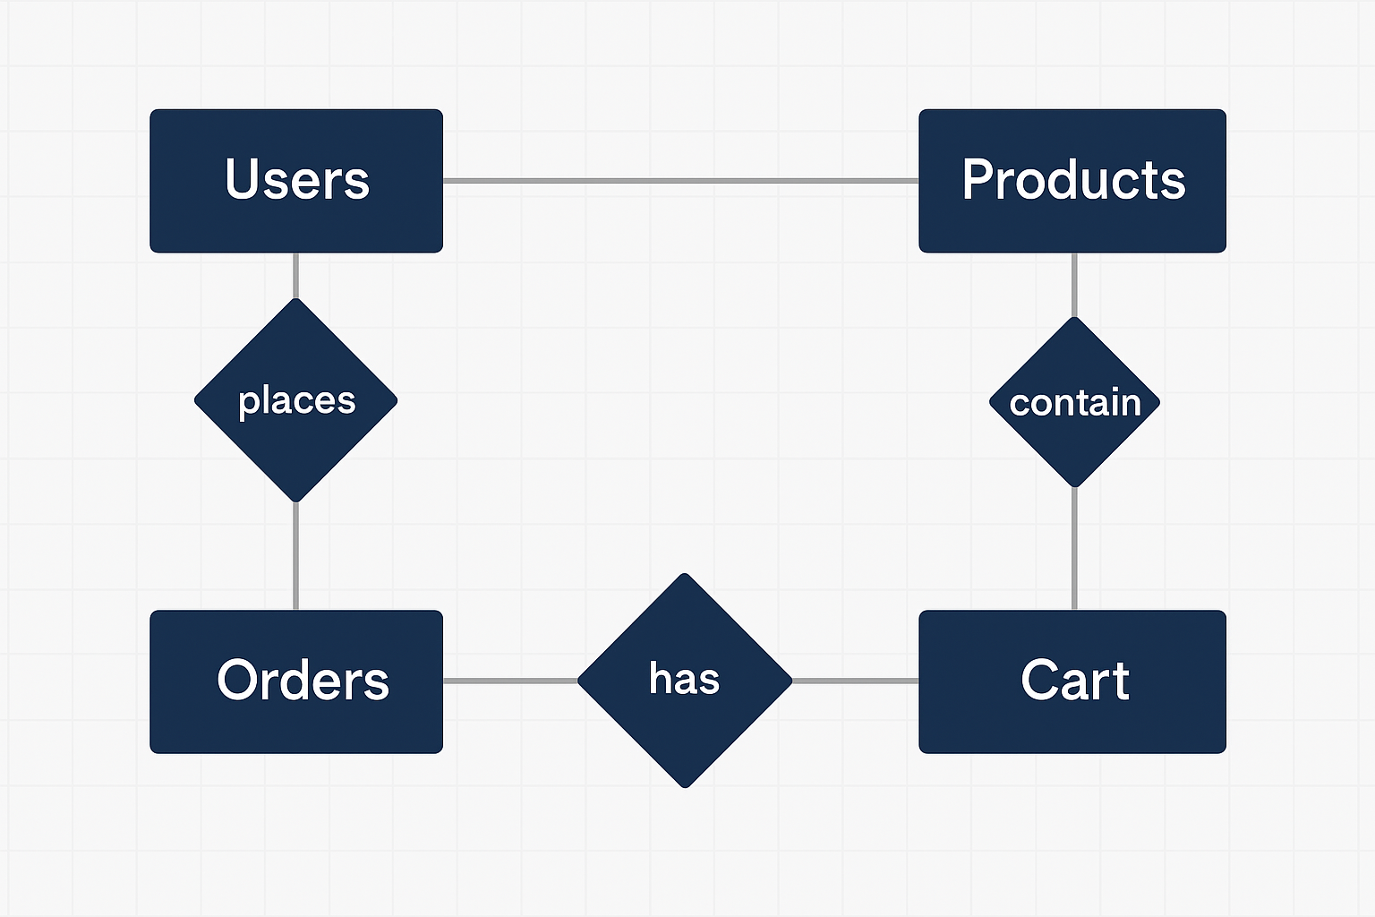
Swag Labs E-Commerce Database Entity-Relationship Model

Slide 7
Programming Languages and Frameworks :
Programming Languages:
Java: Used for developing automated test scripts.
Frameworks&Tools:
Selenium WebDriver: Framework for browser automation and functional UI testing.
TestNG / JUnit: Testing frameworks used to structure and run test cases.
Maven / Gradle: Build tools used for managing project dependencies and execution.
Git: Version control system used for tracking code changes and team collaboration.
Jira: Used for test case management, bug tracking, and sprint planning.

Slide 8
Life Application +Test:
Real-Life Application:
Emulates a complete end-to-end e-commerce journey — from login to successful checkout.
Reflects real user interactions with product browsing, cart management, and order placement.
Provides a practical model for training QA teams or enhancing existing retail platforms.
Testing Strategy:
Manual Testing: Conducted for usability, interface consistency, and real-user scenarios.
Automated Testing: Implemented using Selenium and Java to validate core functions like login, add-to-cart, and checkout.
Ensures that the system meets performance benchmarks, is user-friendly, and remains secure under various conditions.

Slide 9
Project Deliverables:
A comprehensive Test Plan covering both manual and automated testing scenarios.
Realistic test cases that reflect typical user behavior and edge cases.
Detailed bug reports including severity levels and clear reproduction steps.
Automated testing scripts developed using Selenium and Java.
A professional presentation summarizing the project workflow and key outcomes.
An executive summary highlighting the main points, challenges faced, and implemented solutions.

Slide 10
Project Team:

Slide 11
THANK YOU!

